Slide 1
Consumer Advisory Panel Meeting 34
Thursday, 15 August 2024

Slide 2
Greeting and Acknowledgement of Country
Leanne Muffet Independent Facilitator

Slide 3
Acknowledgement of Country
We acknowledge the Traditional Owners of the land on which we meet and pay our respects to their Elders past and present. We extend that respect to other Aboriginal and Torres Strait Islander people who are present today.

Slide 4
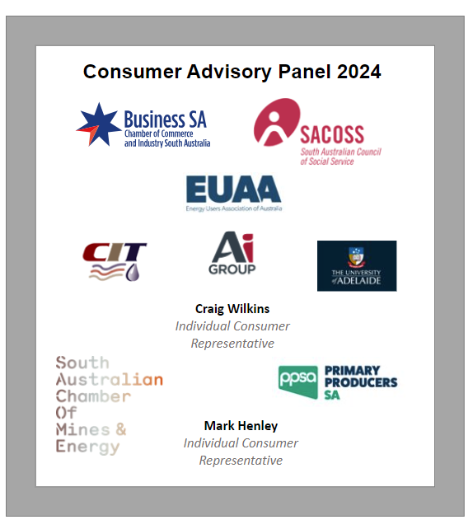
Agenda Outline
Welcome, meeting minutes and action items
Reflections on the breakfast
Hot topics – items on CAP members’ minds
Update on ISP - Brad Harris + Mark Henley
Update on Co design workshop - Leanne Muffet + Alycia Martin
Presentation
- Georgie Morris
7. Brainstorm – Annual Review

Slide 5
Action Items
No | Action | Responsible | Status
1 | ElectraNet to send a high-level summary of the ISP actionable items to the CAP by the morning of June 26 (day of the announcement). The possibility of a breakfast briefing was suggested and will be confirmed directly with the CAP members. | CH/AM | Complete
2 | ElectraNet to arrange a Codesign workshop in July/ Aug to develop the approach to CAP engagement on both ISP projects and the development of the revenue proposal | CH/AM | Complete
3 | ElectraNet to arrange a meeting with the CAP & ENA to discuss social license research slides | CH/AM | Ongoing

Slide 6
Reflections on the breakfast briefing
Leanne Muffet Independent Facilitator

Slide 7
Hot Topics
Leanne Muffet Independent Facilitator

Slide 8
Updates on ISP
Brad Harrison
Manager of Network Planning &
Mark Henley
CAP Member & Chair National ISP Consumer Panel

Slide 9
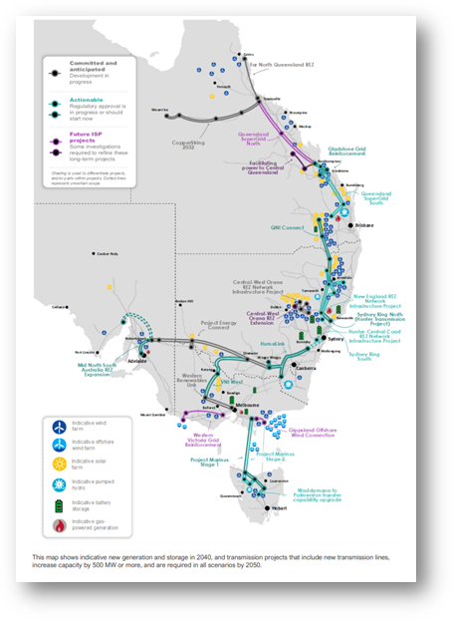
AEMO’s 2024 Integrated System Plan Outcomes
Changes from Draft to Final ISP
Seven new national actionable projects in final ISP
SA Actionable Project - GEN

Slide 10
AEMO’s 2024 Integrated System Plan Outcomes
Mid North SA REZ - Identified Need (directly from the ISP):
The identified need for Mid North South Australia REZ Expansion is to increase power system capability of the transmission network to:
support the expected increase in renewable generation north of Adelaide to support growing demand in Adelaide,
ensure adequate network capacity and supply for large industrial loads, and
alleviate congestion on renewables from the Mid North to rest of the National Electricity Market (NEM).
TABLE: ISP Net-Market Benefits
Scenario | Weighting | Timing | Net Benefit of mid north REZ augmentation | Net Benefit of ODP
Step Change | 43% | 2029-30 | $24m | $16.66B
Progressive Change | 42% | 2047-48 | -$120m | $13.64B
Green Energy Exports | 15% | 2029-30 | $370m | $59.6B
Step Change Additional Load Sensitivity | Alternative to Step Change | 2029-30 | $75m | $43.46B

Slide 11
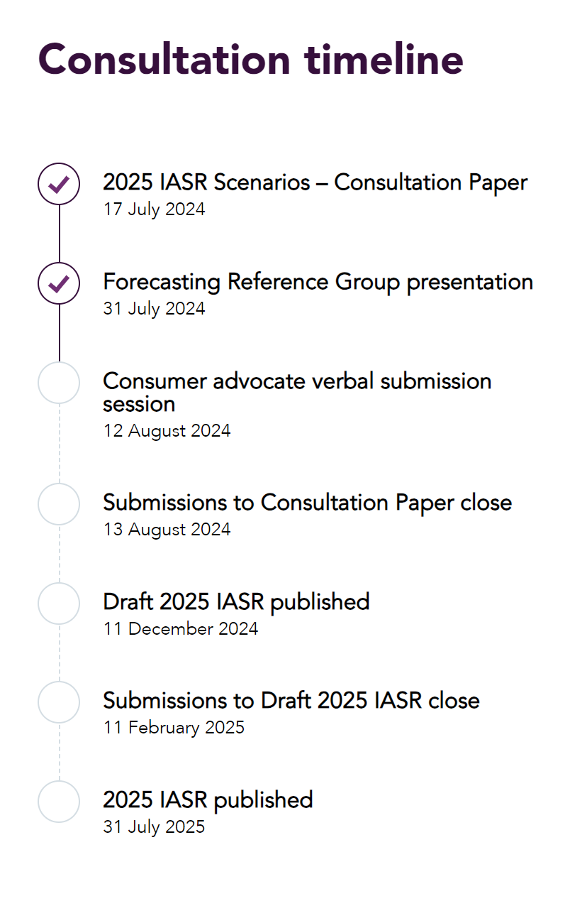
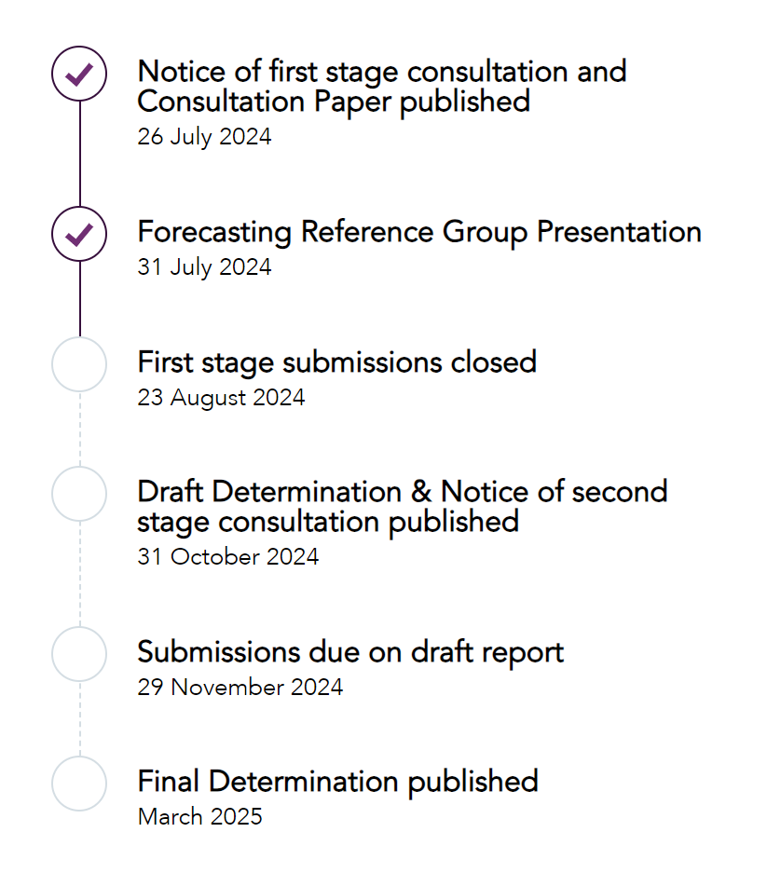
AEMO Consultation – 2026 Integrated System Plan (Three key processes)
AEMO Demand Forecasting
Methodology Consultation
2025 IASR Consultation
ISP Methodology
ISP Methodology Issues Paper
23 October 2024
Draft ISP Methodology
13 March 2025
ISP Methodology Published
25 June 2025

Slide 12
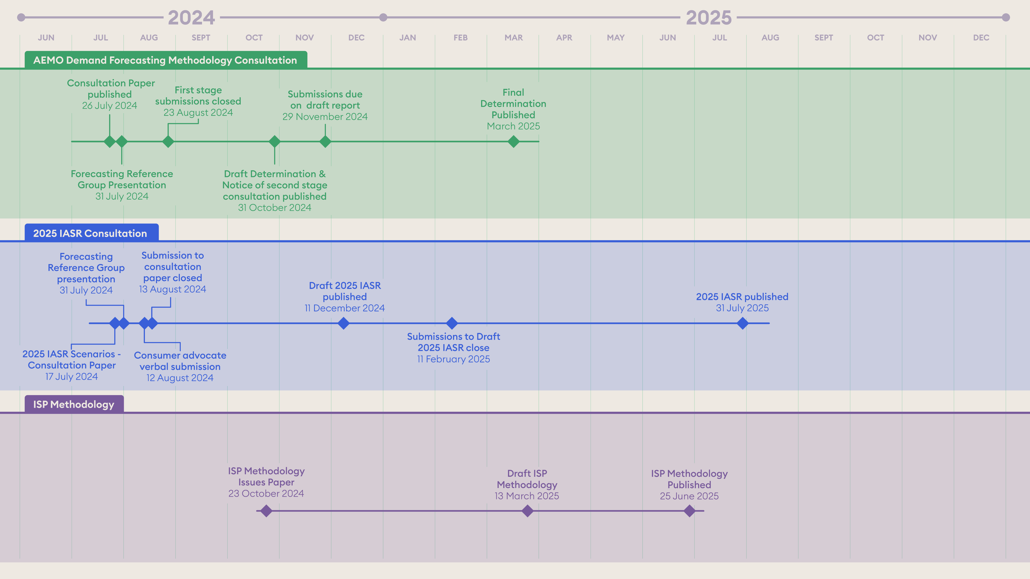
AEMO Consultation – 2026 Integrated System Plan
INSERT TIMELINE

Slide 13
GEN - Regulated Investment Test for Transmission
Project Assessment Draft Report
Contingent Project Application: Stage 1
Project Assessment Conclusions Report + Contingent Project Application: Stage 2
AEMO Integrated System Plan published
26 June 2024
AEMO Integrated System Plan published
26 June 2024
Review PADR submissions
29 December 2025
CPA/RIT-T AEMC Rule Change
September 2024
Draft Project Assessment Conclusions Report (PACR) – CAP Engagement
February 2026
GEN – Non-Network Solutions (submission close)
18 September 2024
GEN PADR published
01 December 2025
CPA-1 Application
January 2025 – April 2025
PACR Published
02 March 2026
GEN PADR submissions/dispute period close
20 March 2026
Contingent Project Application (2)
May 2026 – June 2026
IAP2 Spectrum
Involve/Collaborate | Consult | Inform

Slide 14
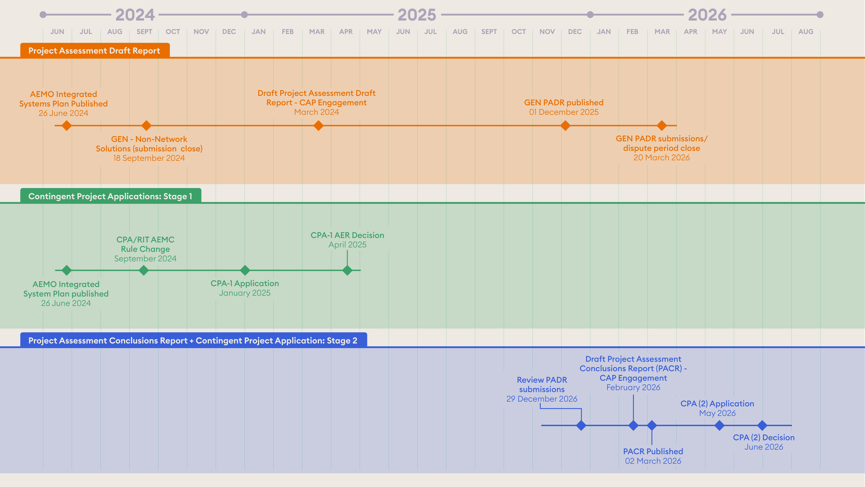
GEN - Regulated Investment Test for Transmission
INSERT TIMELINE

Slide 15
Update on ISP (Integrated System Plan)
For ElectraNet CAP 15/8/2024
Mark Henley

Slide 16
Hug pylons, not trees
Economic growth should help, not hinder, the fight against climate change – The Economist, April 2023

Slide 17
Globally: $1.1trn a year needed between now and the middle of the century for Grids and Storage.
The Energy Transitions Commission, sees the split in costs between the new generating capacity needed for an ample supply of clean electricity and the distribution, transmission and storage systems needed to make that supply useful as a roughly 55:45 proposition, 45% goes on grids and storage. – The Economist

Slide 18
What is the ISP?
“AEMO’s Integrated System Plan (ISP) is a roadmap for the transition of the National Electricity Market (NEM) power system, with a clear plan for essential infrastructure that will meet future energy needs. The ISP’s optimal development path (ODP) sets out the needed generation, storage and network investments to transition to net zero by 2050 through current policy settings and deliver significant net market benefits for consumers.”
It was a recommendation of the Finkel Review, which was initiated by COAG Energy Council in Oct 2016 as a major review of the NEM.

Slide 19
ISP Requirements (what’s in and who says?)

Slide 20
ISP Development cycle: Scenarios draft IASR (Dec24) Final IASR, Methodology Draft ISP (Dec25) Final ISP(June 2026)

Slide 21
Best graph in 2024 ISP!

Slide 22
Overview: ISP Major Projects CAP involvement 2024

Slide 24
2024 ISP Summary

Slide 25
ElectraNet CAP role
Heard concerns from ElectraNet about growing load in northern SA with no additional transmission provision in draft ISP.
Considered concerns
Met with AEMO – video link
Made submission to AEMO to back up ElectraNet conversations.

Slide 26
Current Status: 2026 ISP and Beyond

Slide 27
2024 ISP Scenarios (X-axis is Energy Sector contribution to decarbonization)

Slide 28
Scenarios for 2026 ISP

Slide 29
Considerations for Consumers
Who Pays? Approx trebling of Australian electricity network asset value between now and 2025
Winners and losers in the Transition within and between: Household, SME and C&I ‘sectors.’
Social License?
Transmission to the max vs much more distributed energy (including CER and DER)
How much CER orchestration (Coordination) will be4 achieved
National, integrated plan vs collation of jurisdictional plans
Gas! How much? When? Which one?
Where will ‘firming’ come from and how will it be achieved?
Next innovation?

Slide 30
Next Steps – for CAP?
Consultation on Scenarios is just concluding
December 2024: draft Inputs, Assumptions and Scenarios Report (IASR) released with call for submissions. Maybe CAP plans to look at this document early in 2025?
Maybe meet with AEMO on data development as final IASR released.
December 2025:draft ISP released, again, maybe CAP reviews this early in 2026?

Slide 31
Findings on Codesign Workshop Alycia Martin + Leanne Muffet

Slide 32
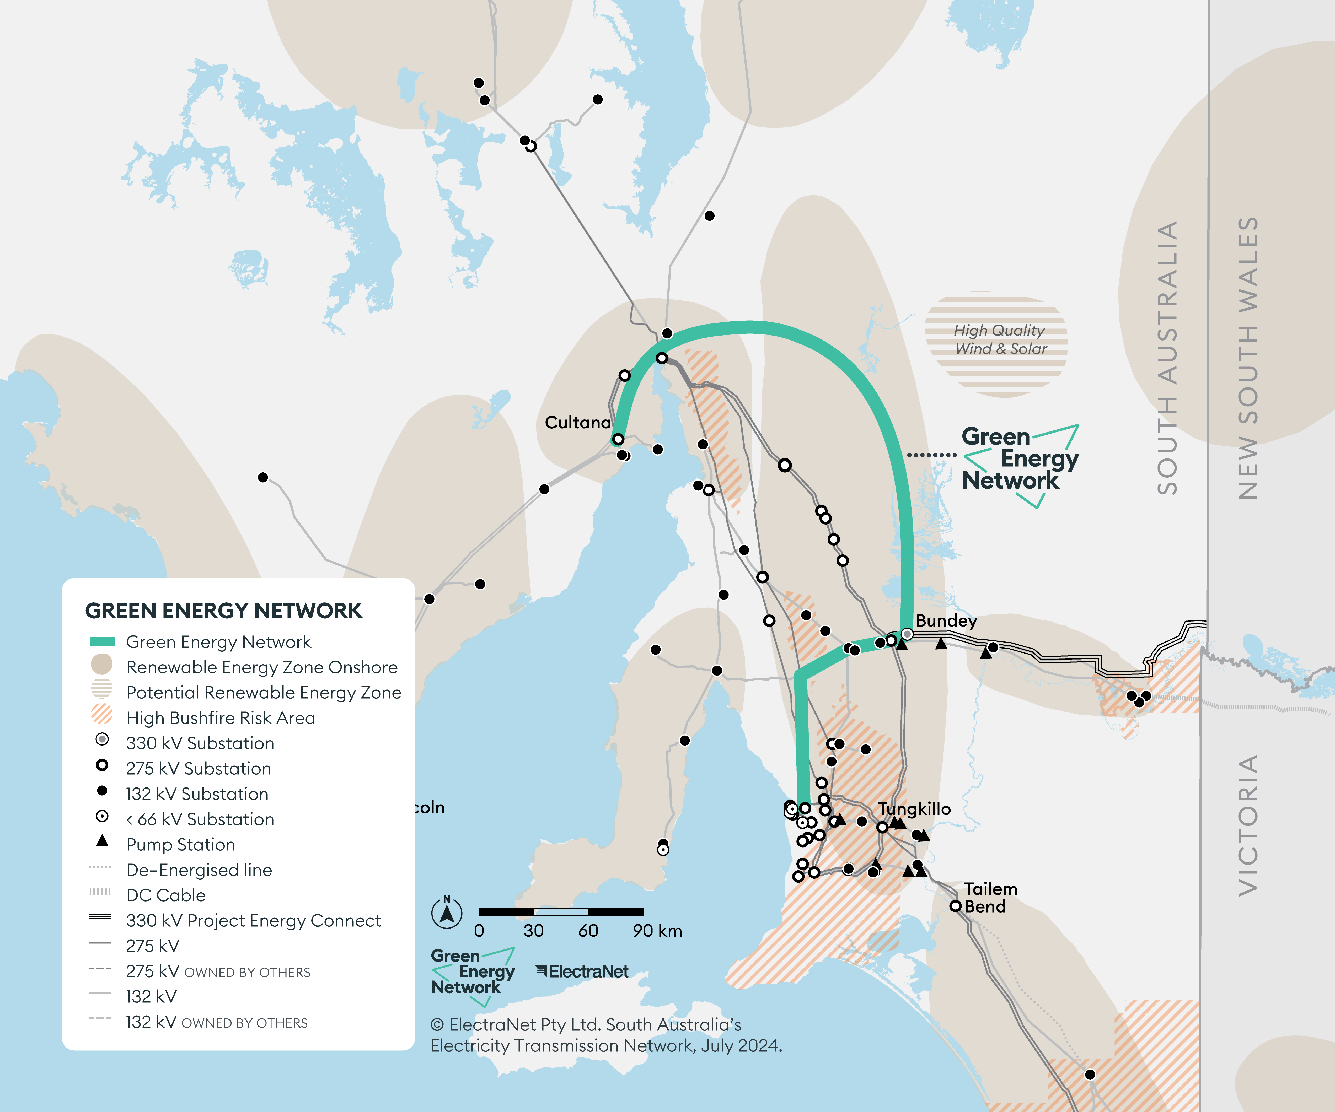
Notes:
Alycia

Slide 33
Green Energy Network (GEN) project
POSSIBLE COMMUNITY / CONSUMER CONCERNS
Name of the project (greenwashing)
Uncertainty around cost and electricity loads.
Who's paying and who's benefiting?
Risks for late delivery
Ensure an analysis of load impacts versus costs
Native vegetation / biodiversity
Cultural sites
If we don't build transmission where is SA going to get power/ generation from?
Interface with State Government election (March 2026)
IDEAS TO ENGAGE WITH THE COMMUNITY
Different messages for North + South lines
Recognise successful engagement will be multifaceted
Use multiple engagement tools
Early and ongoing information will be crucial (staged information)
Test the CONCEPTUAL route / pathways and anticipated costs with the community members
Social media needs to be smart and on the front foot
Environmental Impact Statement [EIS] is seen as a key and non-negotiable
Notes:
Name of the project
Costs – risk for late
Native vegetation/ cultural
1- 4

Slide 34
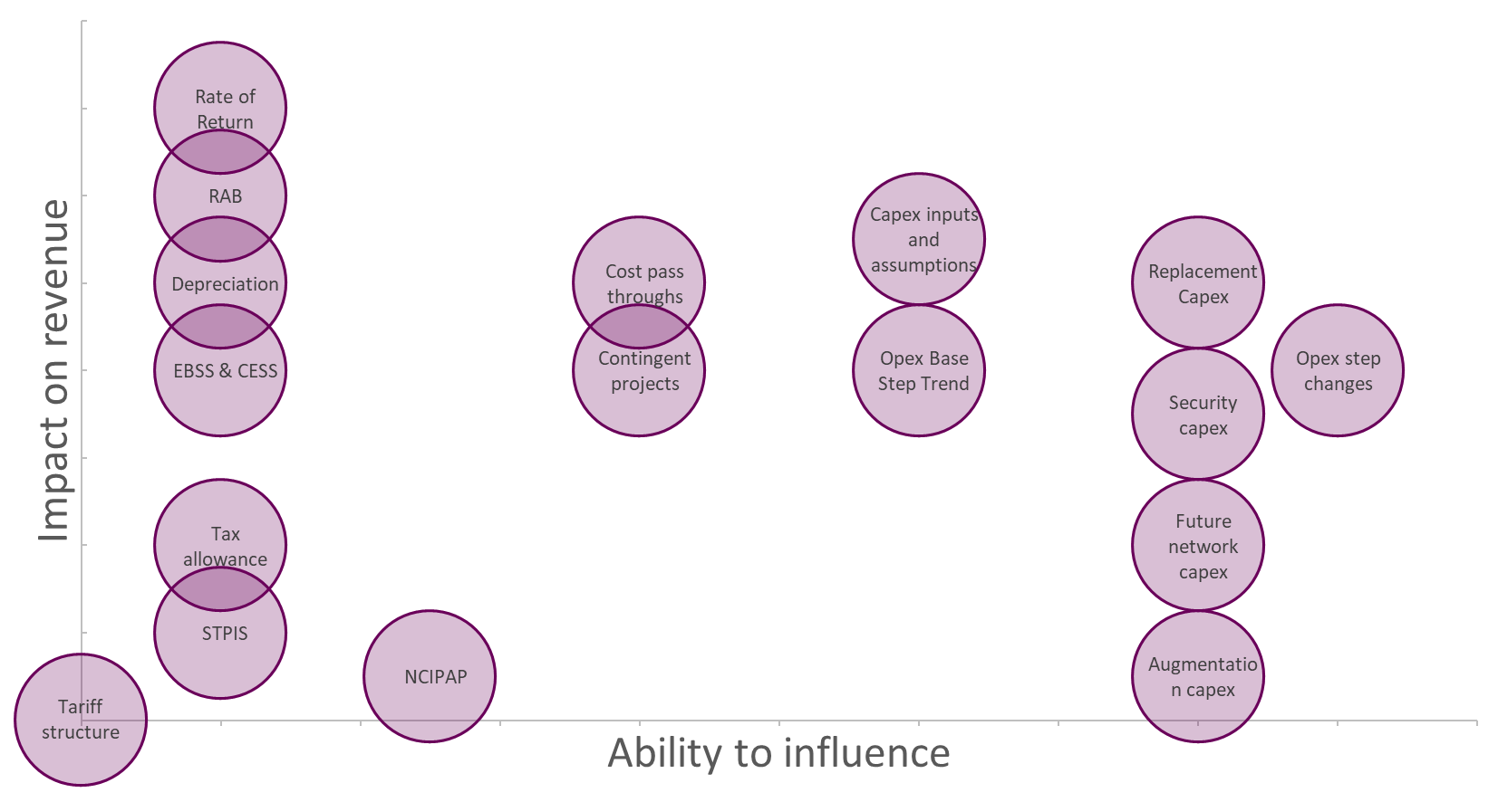
Revenue Proposal (part a)
POSSIBLE COMMUNITY / CONSUMER CONCERNS
Cost and consumer prices
Reliability of power over time
Risk of under or over delivering infrastructure
ISSUES THAT THE CAP WOULD LIKE TO EXPLORE
The assumption behind demand modelling/ predictions
The assumptions behind risk modelling
exploration of the graphs that Jeremy presented [impact on revenue V ability to influence]

Slide 35
Revenue Proposal (part b)
Extra information the CAP would like from ElectraNet to create confidence in ElectraNet’s proposal
Asset management processes, principles and samples
Deliverability Information
Demand forecasting (drivers and customer segmentation)
ElectraNet’s role in moving to net zero
The ability to Commission independent technical/ economic advice to deepen our understanding
Cost impact analysis
ElectraNet’s ability to share cost impacts with consumers

Slide 36
Next Steps
Summary on
Cost/benefit - who pays? what are the solutions, what’s does the modellings say? what demand is included ? What new load is connecting?
Early works funding - Investments upfront or down the track (risk mitigations)
Community and environmental approval - landholders, Traditional Owners, environmental sector
Project delivery- are we able to deliver?, when, cost, enough resources, late vs early – cost and benefits?
Action: ElectraNet to prepare clear project timeframes for the Northern and Southern projects and determine when the CAP should be engaged.
CAP Action: How do the CAP want to be engaged on the Revenue proposal and Project GEN (Mid North/Southern Projects).
Deep dive sessions?
Establishment of Working groups/sub committees
Action: ElectraNet to arrange a briefing from the cultural heritage team to the CAP to gain a better understanding of the work that is being undertaken.

Slide 37
Presentation
Georgie Morris CAP Member

Slide 38
SA Energy Affordability
AER and ACCC Data

Slide 39
SA Energy Affordability
South Australian energy consumers are continuing to experience a worsening energy affordability crisis.
The AER’s most recent retail performance data for Q3 2023/24 shows increasing numbers of South Australian energy customers are repaying energy debt, and have the highest average debt levels in the Nation.
It is clear that energy is no longer affordable for many households in this State.

Slide 40
AER Q3 2023/24 - debt and payment difficulty data
South Australia has the highest average energy debt in National Energy Market (NEM) jurisdictions. The average energy debt of (non-hardship) residential customers in SA is $1,379 (up from $1,227 12 months ago), $286 above the National average of $1093.
The number of customers repaying energy debt in South Australia has continued to increase from 22,331 in Q1 2022-23 to 29,862 in Q3 2023-24 (an increase of 33.7% in 18 months). This is in line with the 35% increase in the number of customers repaying energy debt seen Nationally from Q1 2022-23 to Q3 2022-23 (increasing from 154,300 to 208,380 in Q3 2023-24).
There have been consecutive quarterly increases in the number of customers repaying energy debt over the last two quarters with 29,103 South Australian customers repaying energy debt in Q2 2023-24 (an increase of 12.6% from Q1 2023-24) and 29,862 in Q3 2023-24.
The average debt on entry into hardship programs for SA customers in Q3 2023-24 was $1,668 (the highest after Tasmania), and $444 above the national average of $1,224. Average debt on entry into a hardship program in South Australia has increased by $193 from $1,475 in Q2 2023-24.

Slide 41
AER debt and hardship data
The average debt of hardship customers in SA has decreased in the last 12months – from $2,534 in Q3 2022-23, to $2,160 in Q3 2023-24, but is still $480 above the National average of $1,680 (and is up $297 from pre-pandemic levels of $1,863 in 2018-19). Tasmania is the only state with higher average hardship debt – at $2,506.
The percentage of residential customers in SA entitled to a concession is marginally down from 26.5% (213,706) in Q3 2022/23 to 23.75% (193,974) in Q3 2023/24.
South Australia has the lowest percentage of hardship customers receiving a concession in the NEM. The number of hardship customers receiving concession in South Australia is 7,418 – or 37.49% of hardship customers. This is up from 6,536 hardship customers in Q3 2022/23, but is down on the previous percentage (40.38% in Q3 2022/23). Nationally, 53.11% of hardship customers are receiving a concession, with Tasmania having the highest percentage at 67.11%.

Slide 42
AER Q3 2023/24 data
In Q3 2023/24, 834 customers were disconnected in SA, compared to 798 during the same quarter 12 months ago. There has been a significant increase in the number of disconnections from the last quarter (Q2 2023/24), virtually doubling (up by 94%) from 428.
The number of customers on payment plans in SA has decreased by 1,176 or 7% in three months, from 16,399 or 2.0% of customers in Q2 2023/24, to 15,223 or 1.9% of customers in Q3 2023/24, and is still well below pre-pandemic levels (down from 2.7% of customers in 2017/18).
Hardship customer numbers in SA have increased by 22% in the past 12 months, up from 16,202 in Q3 2022-23 to 19,784 in Q3 2023/24 (or 2.42% of customers). This may be in response to the AER’s Compliance and Enforcement priorities, and the industry guidance letter sent to retailers in January 2024 about identifying customers experiencing payment difficulty and hardship.

Slide 43
Retail TOU customers in SA
Around 39% of ALL energy customers (or 298,175 customers) are currently on time of use (TOU) retail tariffs in South Australia, and SACOSS suggests many of these households do not know they are on a TOU, and even if they do know, cannot change energy usage patterns and are at risk of experiencing extreme bill shock.
3.6% of SA smart meter customers were on a TOU retail tariff in 2020/21, and 83.8% of SA smart meter customers are now on a TOU retail tariff:
90% of AGL’s smart meter customers in SA are on a TOU retail tariff
97.7% of Alinta’s smart meter customers in SA are on a TOU retail tariff
100% of Origin’s smart meter customers in SA are on a TOU retail tariff

Slide 44
Energy Affordability – effective unit price
South Australian households also continue to pay the highest per unit electricity prices in the Nation, significantly contributing to the energy affordability crisis in this State.
The ACCC’s Inquiry into the National Electricity Market Report, published in June 2024, shows the median effective price for electricity in South Australia continued to increase in the last two quarters of 2023/4 to reach nearly 40 c/kWh in Q3 2023/24, well above other States.

Slide 45
SA Effective Electricity Prices

Slide 46
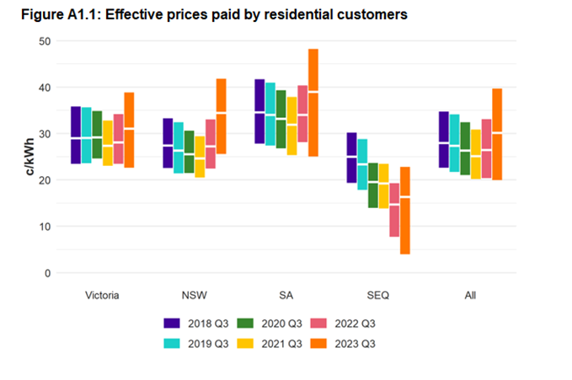
Energy Price increases
We know that from 1 July 2023, South Australians experienced dramatic energy price increases for both standing offer and market offer customers.
The ACCC’s June Report shows the sharp increases effective prices for South Australian households in Q3 2023, reaching as high as 48 c/kWh

Slide 47
Network Costs – highest % in NEM jurisdictions

Slide 48
DMO cost stack analysis by DNSP

Slide 49
VDO Cost stack
Notes:
Notably, the VDO has a significantly lower wholesale cost component than South Australia’s DMO 6 ($492 compared to $806), and significantly lower network costs ($593 compared to $922); resulting in an annual difference between these two offers of $643, for these two cost components alone. The retail cost component and retail margin are also higher in South Australia ($271 and $134 respectively) than Victoria ($186 and $80), but this could be explained by lower average energy debt and the long-completed smart meter roll-out in Victoria.

Slide 50
Need for additional energy consumer protections
The ACCC’s December 2023 Inquiry into the National Electricity Market Report supports the need for additional residential energy market pricing and contract protections.
The ACCC found that approximately 70% of customers in 2023 are on Older Plans, compared to 30% of customers on Newer Plans, and 82% of residential customers were on calculated annual prices at or above the median offer on Energy Made Easy and Victorian Energy Compare, up from 43% in 2022.
In all states, customers on Older Plans are paying higher average prices than those on Newer Plans.
Showing retailers are pricing existing customers differently to ‘acquisition’ offers, and customers need to continually re-engage in the market to obtain the ‘benefits’ of competition.

Slide 51
SA households paying above the DMO
The ACCC found that nearly half (47%) of all customers and 42% of concessions customers are paying equal to or above the DMO price, and that 79% of customers would be better off if they switched to competitive acquisition offer in Energy Made Easy
South Australia, the ACCC found that 61% of South Australian energy customers on flat rate plans are paying at or above the DMO, with 9% of customers paying 25% or more above the DMO in 2023
Notes:
The ACCC’s December 2023 Inquiry into the National Electricity Market Report supports the need for additional residential energy market pricing and contract protections.
The ACCC found that approximately 70% of customers in 2023 are on Older Plans, compared to 30% of customers on Newer Plans, and 82% of residential customers were on calculated annual prices at or above the median offer on Energy Made Easy and Victorian Energy Compare, up from 43% in 2022.
In all states, customers on Older Plans are paying higher average prices than those on Newer Plans.
Showing retailers are pricing existing customers differently to ‘acquisition’ offers, and customers need to continually re-engage in the market to obtain the ‘benefits’ of competition.

Slide 52
‘Average’ annual Usage
In addition to the price of electricity, the calculation of ‘average annual usage’ is key to an analysis of energy affordability in this State.
Despite having amongst the lowest average annual household electricity usage in the Nation (South Australia is 4,583 kWh and Victoria is 4,561 kWh due to high gas penetration), South Australia has amongst the most unaffordable energy in the NEM.

Slide 53
Annual grid usage - NEM

Slide 54
SA - Declining Residential Grid consumption

Slide 55
Declining grid consumption Nationally
Notes:
Notably, the ACCC’s June Report pointed to usage levels recorded in quarter 3 of 2023 that were the lowest in the ACCC’s historical data (see Figure 18, below), indicating that recent reductions in median usage have had the effect of offsetting effective price increases for those households that consume less energy from the grid, finding that:
‘Possible factors contributing to low usage in quarter 3 2023 are warm weather, high rooftop solar output, and customers deliberately reducing their usage in response to rising electricity prices. Among these factors, warm weather is likely the most significant, with 2023 having one of the warmest winters on record.’
ACCC, Inquiry into the National Electricity Market Report, June 2024, p.30

Slide 56
National AEMO residential demand forecast

Slide 57
Payment Plan and Hardship customer Grid usage
Hardship and payment-plan customer groups have significantly higher usage than the model annual usage assumption used for calculating the Default Market Offer, which is around 1,000 kWh per quarter in most regions.
For South Australia, the ACCC’s data shows the median grid usage for hardship customers (not on a concession) for 2022-23 was 7,684 kWh, with hardship customers on the 75th percentile using 11,035 kWh in that year.
The median usage of a hardship customer was 66% higher than the median usage of a South Australian residential customer in 2022-23, leading to much higher bills. For customers on a payment plan (not receiving a concession) median usage was 6,686 kWh for 2022-23 and up to 9,535 kWh for the 75th percentile
This has significant implications for energy affordability analysis and the pricing of standing offers in this State.
ACCC - Higher usage among some customer groups could be driven by these groups having more people per household. Another factor could be that these households are less able to afford (or are otherwise restricted from accessing) more energy-efficient housing, appliances, and rooftop solar. This is particularly relevant for customers who rent their homes, as they typically don’t have control over most of these factors

Slide 58
Grid usage by customer group in SA
Notes:
To truly understand the drivers of energy unaffordability in this State, it is imperative that consistent, reliable energy usage data is made publicly available. Energy costs are regressive, and for those households that are unable to reduce their grid consumption, the burden of spending around 8% of their income to pay for this essential service may simply be insurmountable, particularly when coupled with the rising cost of housing, leading inevitably to energy insecurity, debt and hardship. An analysis of energy usage will support the development of policies to prevent burgeoning energy debt levels, including different pricing structures as well as energy efficiency mandates for renters and people on low incomes. It may also inform a better understanding of energy rationing behaviour, which we understand anecdotally is on the rise with increasing energy costs, and can lead to serious health implications for many households.

Slide 59
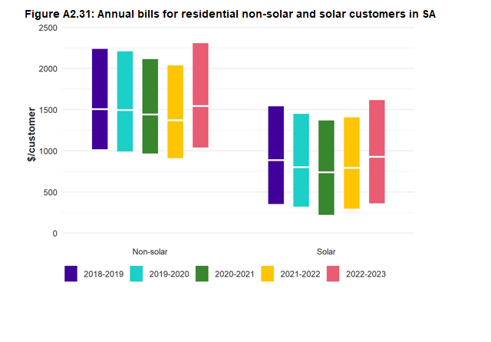
Solar vs non solar usage
ACCC’s recent data shows solar customers use more electricity from the grid than non-solar. This doesn’t align with bill analysis.
Notes:
SACOSS considers the ACCC’s solar grid usage data for South Australia does not necessarily align with data on annual bills and effective prices for solar customers. A simple analysis of median solar customer usage for 2022-23 (5,306 kWh) multiplied by median solar customer effective prices for 2022-23 (31.8 c/kWh) results in a bill of around $1,644 (this should account for solar rebates), 77% higher than the median solar bill of $928. Also, simply dividing the annual median solar electricity bill for 2022-23 (92,800 cents) by the solar median usage (5,306 kWh), results in a 17.4 c/kWh median unit price (45% lower than 31.8 c/kWh).
The same analysis for a non-solar customer provides results that do not contain the same stark variations. A simple multiplication of annual grid usage (4,148kWh) by median effective price (43.8ckWh) results in a bill of around $1,816, which is 17% higher than the ACCC’s median average of $1,544. Dividing the median bill (154,400 cents) by the median usage (4,148kWh) results in a unit price of 37.2ckWh (15% lower than 43.8ckWh).

Slide 60
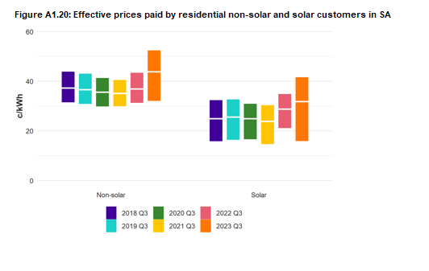
Effective Prices for solar vs non-solar in SA
Non-solar customers pay around 43.8 c/kWh (median) effective price.
Solar pay around 31.8 c/kWh (median) effective price (12 c/kWh less).

Slide 61
TOU Prices largely align with flat tariffs

Slide 62
SA TOU customers paying more than the DMO
Notes:
The ACCC’s recent analysis of TOU plans in South Australia found that in 2023-24, for three retailers (anonymised), between 85% and 100% of customers were paying tariffs that were at or above the DMO

Slide 63
Brainstorm – Annual Review
Leanne Muffet Independent Facilitator

Slide 64
Wrap up, recap and next steps
Chris Hanna
Manager, Corporate Affairs

Slide 65
CAP only session
Leanne Muffet Independent Facilitator

